Slide 1
PHP – Functions
A simple function declaration
<?php
function time_machine($a)
{
echo time() + $a;
}
?>
This call uses the built-in PHP time function to fetch the current timestamp
Timestamp: an integer number representing a date and time based on the number of seconds since 00:00 a.m. on January 1, 1970

Slide 2
PHP – Variable Scope
Local variables are variables that are created within, and can be accessed only by, a function.
They are generally temporary variables that are used to store partially processed results prior to the function’s return
Example:
<?php
function longdate($timestamp)
{
$temp = date("l F jS Y", $timestamp);
return "The date is $temp";
}
?>
Here we have assigned the value returned by the date function to the temporary variable $temp, which is then inserted into the string returned by the function.
As soon as the function returns, the value of $temp is cleared, as if it had never been used at all.

Slide 3
PHP – Variable Scope
<?php
$temp = "The date is ";
echo longdate(time());
function longdate($timestamp)
{
return $temp . date("l F jS Y", $timestamp);
}
?>
Here $temp has been created before we call the longdate function.
However, because $temp was neither created within the longdate function nor passed to it as a parameter, longdate cannot access it. Therefore, this code snippet outputs only the date, not the preceding text

Slide 4
PHP – Variable Scope
Let’s see some ways to repair the previous code
// Rewriting to refer to $temp within its local scope fixes the problem
<?php
$temp = "The date is ";
echo $temp . longdate(time());
function longdate($timestamp)
{
return date("l F jS Y", $timestamp);
}
?>
The code here moves the reference to $temp out of the function.
The reference appears in the same scope where the variable was defined.

Slide 5
PHP – Variable Scope
//An alternative solution: passing $temp as an argument
<?php
$temp = "The date is ";
echo longdate($temp, time());
function longdate($text, $timestamp)
{
return $text . date("l F jS Y", $timestamp);
}
?>
The solution showed here passes $temp to the longdate function as an extra argument.
longdate reads it into a temporary variable that it creates called $text and outputs the desired result.

Slide 6
Global variables
To declare a variable as having global scope, use the keyword global.
Let’s assume that you have a way of logging your users into your website and want all your code to know whether it is interacting with a logged-in user or a guest.
One way to do this is to create a global variable such as $is_logged_in:
global $is_logged_in;

Slide 7
Global variables
You should use global variables with caution, though.
I recommend that you create them only when you absolutely cannot find another way of achieving the result you desire.
If you have a thousand-line program (and some day you will) in which you discover that a global variable has the wrong value at some point, how long will it take you to find the code that set it incorrectly?
Also, if you have too many global variables, you run the risk of using one of those names again locally, or at least thinking you have used it locally, when in fact it has already been declared as global.
In general, programs that are broken into small parts and segregated data are less buggy and easier to maintain.
Notes:
To make global variables more visible, try making their names uppercase

Slide 8
Static Variable
//A function using a static variable
<?php
function test() {
static $count = 0;
echo $count;
$count++;
}
?>
Here the very first line of function test creates a static variable called $count and initializes it to a value of 0.
The next time the function is called, because $count has already been declared, the first line of the function is skipped.
Then the previously incremented value of $count is displayed before the variable is again incremented.

Slide 9
Static Variable
If you plan to use static variables, you should note that you cannot assign the result of an expression in their definitions.
They can be initialized only with predetermined values.
//Allowed and disallowed static variable declarations
<?php
static $int = 0; // Allowed
static $int = 1+2; // Disallowed (will produce a Parse error)
static $int = sqrt(144); // Disallowed
?>

Slide 10
Superglobal variables
Starting with PHP 4.1.0, several predefined variables are available.
These are known as superglobal variables, which means that they are provided by the PHP environment but are global within the program, accessible absolutely everywhere.
These superglobals contain lots of useful information about the currently running program and its environment
They are structured as associative arrays

Slide 11
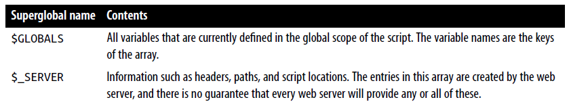
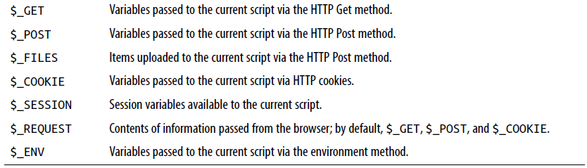

Slide 12
Superglobal Variables
All of the superglobals (except for $GLOBALS) are named with a single initial underscore and only capital letters
Therefore, you should avoid naming your own variables in this manner to avoid potential confusion.
Example: The URL of the page that referred the user to the current web page.
$came_from = $_SERVER['HTTP_REFERER’];
Oh, and if the user came straight to your web page, such as by typing its URL directly into a browser, $came_from will be set to an empty string.

Slide 13
Superglobals and security
A word of caution is in order before you start using superglobal variables, because they are often used by hackers trying to find exploits to break into your website.
What they do is load up $_POST, $_GET, or other superglobals with malicious code, such as Unix or MySQL commands that can damage or display sensitive data if you naïvely access them.
Therefore, you should always sanitize superglobals before using them.

Slide 14
Superglobals and security
One way to do this is via the PHP htmlentities function.
It converts all characters into HTML entities
For example, less-than and greater-than characters (< and >) are transformed into the strings &lt; and &gt;
So that they are rendered harmless, as are all quotes and backslashes, and so on.

Slide 15
Superglobals and security
Therefore, here is a much better way to access $_SERVER (and other superglobals) is:
$came_from = htmlentities($_SERVER['HTTP_REFERER']);
Using the htmlentities function for sanitization is an important practice in any circumstance where user or other third-party data is being processed for output, not just with superglobals.

Slide 16
Expressions and Control Flow in PHP
Let’s start with the most fundamental part of any programming language: expressions
An expression is a combination of values, variables, operators, and functions that results in a value.
y = 3(abs(2x) + 4)
which in PHP would be:
$y = 3 * (abs(2 * $x) + 4);
The value returned (y, or $y in this case) can be a number, a string, or a Boolean value

Slide 17
Expressions and Control Flow in PHP
TRUE or FALSE?
A basic Boolean value can be either TRUE or FALSE.
For example, the expression 20 > 9 (20 is greater than 9) is TRUE, and the expression 5 == 6 (5 is equal to 6) is FALSE.
You can combine Boolean operations using operators such as AND, OR, and XOR, which are covered later
NOTE: I am using uppercase letters for the names TRUE and FALSE.
This is because they are predefined constants in PHP. You can also use the lowercase versions, if you prefer, as they are also predefined.
In fact, the lowercase versions are more stable, because PHP does not allow you to redefine them; the uppercase ones may be redefined—something you should bear in mind if you import third-party code.

Slide 18
Expressions and Control Flow in PHP
<?php
echo "a: [" . (20 > 9) . "]<br>";
echo "b: [" . (5 == 6) . "]<br>";
echo "c: [" . (1 == 0) . "]<br>";
echo "d: [" . (1 == 1) . "]<br>";
?>
This example shows some simple expressions:
The two I just mentioned, plus a couple more. For each line, it prints out a letter between a and d, followed by a colon and the result of the expressions.
The <br> tag is there to create a line break and thus separate the output into four lines in HTML.

Slide 19
Now that we are fully into the age of HTML5, and XHTML is no longer being planned to supersede HTML, you do not need to use the self-closing <br /> form of the <br> tag, or any void elements (ones without closing tags), because the / is now optional.
Therefore, I have chosen to use the simpler style here. If you ever made HTML nonvoid tags self-closing (such as <div />), they will not work in HTML5 because the / will be ignored, and you will need to replace them with (for example) <div>...</div>.
However, you must still use the <br /> form of HTML syntax when using XHTML.

Slide 20
Expressions and Control Flow in PHP
<?php
echo "a: [" . (20 > 9) . "]<br>";
echo "b: [" . (5 == 6) . "]<br>";
echo "c: [" . (1 == 0) . "]<br>";
echo "d: [" . (1 == 1) . "]<br>";
?>
The output from this code is as follows:
a: [1]
b: []
c: []
d: [1]
Notice that both expressions a: and d: evaluate to TRUE, which has a value of 1.
But b: and c:, which evaluate to FALSE, do not show any value, because in PHP the constant FALSE is defined as NULL, or nothing

Slide 21
Expressions and Control Flow in PHP
To verify this for yourself, you could enter this code:
<?php // test2.php
echo "a: [" . TRUE . "]<br>";
echo "b: [" . FALSE . "]<br>";
?>
that outputs the following:
a: [1]
b: []
Notes:
By the way, in some languages FALSE may be defined as 0 or even –1, so it’s worth checking on its definition in each language.

Slide 22
Literals and Variables
The simplest form of an expression is a literal, which simply means something that evaluates to itself, such as the number 73 or the string "Hello".
An expression could also simply be a variable, which evaluates to the value that has been assigned to it.
They are both types of expressions, because they return a value.

Slide 23
Literals and Variables
This snippet shows three literals and two variables, all of which return values, albeit of different types.
<?php
$myname = "Brian";
$myage = 37;
echo "a: " . 73 . "<br>"; // Numeric literal
echo "b: " . "Hello" . "<br>"; // String literal
echo "c: " . FALSE . "<br>"; // Constant literal
echo "d: " . $myname . "<br>"; // String variable
echo "e: " . $myage . "<br>"; // Numeric variable
?>

Slide 24
Literals and Variables
And, as you’d expect, you see a return value from all of these with the exception of c:, which evaluates to FALSE, returning nothing in the following output:
a: 73
b: Hello
c:
d: Brian
e: 37

Slide 25
Literals and Variables
In conjunction with operators, it’s possible to create more-complex expressions that evaluate to useful results.
When you combine assignment or control-flow constructs with expressions, the result is a statement.
<?php
$days_to_new_year = 366 - $day_number; // Expression
if ($days_to_new_year < 30)
{
echo "Not long now till new year"; // Statement
}
?>
Notes:
The first assigns the result of the expression 366 - $day_number to the variable $days_to_new_year, and the second outputs a friendly message only if the expression $days_to_new_year < 30 evaluates to TRUE

Slide 26
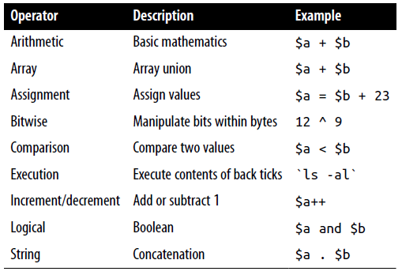
Operators
PHP offers a lot of powerful operators that range from arithmetic, string, and logical operators to assignment, comparison, and more

Slide 27
Operators
Each operator takes a different number of operands:
Unary operators, such as incrementing ($a++) or negation (-$a), which take a single operand.
Binary operators, which represent the bulk of PHP operators, including addition, subtraction, multiplication, and division.
One ternary operator, which takes the form ? x : y. It’s a “single-line if statement” that chooses between two expressions, depending on the result of a third one.

Slide 28
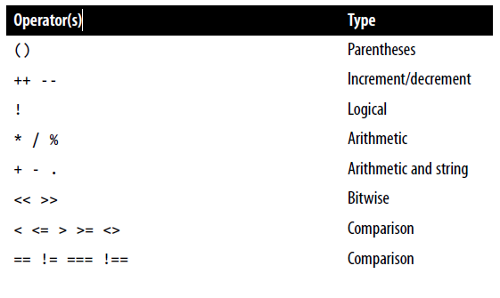
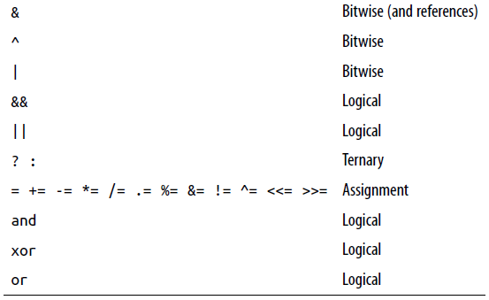
Operators
Precedence of PHP operators (high to low):

Slide 29
Relational Operators
Relational operators test two operands and return a Boolean result of either TRUE or FALSE.
There are three types of relational operators: equality, comparison, and logical

Slide 30
Equality
The equality operator is == (two equals signs).
It is important not to confuse it with the = (single equals sign) assignment operator.
<?php
$month = "March";
if ($month == "March") echo "It's springtime";
?>
As you see, by returning either TRUE or FALSE, the equality operator enables you to test for conditions using, for example, an if statement.

Slide 31
Equality
But that’s not the whole story, because PHP is a loosely typed language.
If the two operands of an equality expression are of different types, PHP will convert them to whatever type makes the best sense to it.
For example, any strings composed entirely of numbers will be converted to numbers whenever compared with a number.

Slide 32
Equality
Here, $a and $b are two different strings, and we would therefore expect neither of the if statements to output a result.
<?php
$a = "1000";
$b = "+1000";
if ($a == $b) echo "1";
if ($a === $b) echo "2";
?>
However, if you run the example, you will see that it outputs the number 1, which means that the first if statement evaluated to TRUE.
This is because both strings were first converted to numbers, and 1000 is the same numerical value as +1000.

Slide 33
Equality
Here, $a and $b are two different strings, and we would therefore expect neither of the if statements to output a result.
<?php
$a = "1000";
$b = "+1000";
if ($a == $b) echo "1";
if ($a === $b) echo "2";
?>
In contrast, the second if statement uses the identity operator—three equals signs in a row—which prevents PHP from automatically converting types.
$a and $b are therefore compared as strings and are found to be different, so nothing is output.
Notes:
As with forcing operator precedence, whenever you have any doubt about how PHP will convert operand types, you can use the identity operator to turn this behavior off.

Slide 34
Equality
In the same way that you can use the equality operator to test for operands being equal, you can test for them not being equal using !=, the inequality operator.
<?php
$a = "1000";
$b = "+1000";
if ($a != $b) echo "1";
if ($a !== $b) echo "2";
?>
As you might expect, the first if statement does not output the number 1, because the code is asking whether $a and $b are not equal to each other numerically.
Instead, it outputs the number 2, because the second if statement is asking whether $a and $b are not identical to each other in their present operand types, and the answer is TRUE; they are not the same.

